Slide 1
DR. SHYAMA PRASAD MUKHERJEE UNIVERSITY
TOPIC:-
Measures of improving agricultural productivity:-

Slide 2
What is Farming/Agriculture?
we can shortly say that “AGRICULTURE IS THE SCIENCE AND ART OF CULIVATING PLANTS AND ANIMALS LIVESTOCK”.
It is the branch of science which deals with the production of plants and animals useful to man.
Involves soil cultivation,breeding and management of crops and livestock.

Slide 3
Why productivity of agriculture is essential?
The productivity of agriculture is essential for many reasons. Providing more food, increasing productivity affects the farming market’s growth, labour migration, and income. Increased agricultural productivity refers to the more efficient distribution of scarce resources. Learning how to improve production is a crucial aspect of productive farming.
New methods and techniques have given farmers a chance to increase production and maintain their farm’s long term sustainability. So, We are here to come with information on the topic to improve Agriculture Productivity.

Slide 4
Measures to Improve Agicultural Productivity in India:
1.Improving Irrigation Facilities
2.Mechanized Agriculture
3.Implementation of land reforms
4.Interplant
5. Plant more crops
6. Plant more densely
7.Raised beds
8.Smart water management
9.Use nitrogen
10.Improve seeds
11.Plant protection
12.Farmers Education
13.Institutional Reforms/arrangements

Slide 5
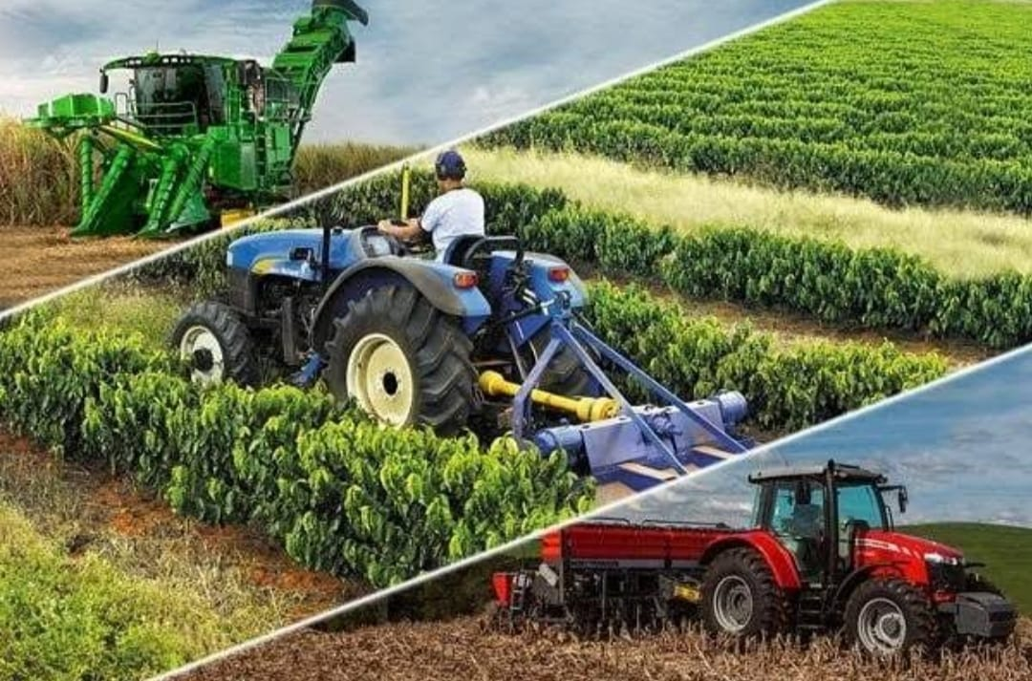
1. Improving Irrigation Facilities:-
Irrigation infrastructure a must to increase the agriculture productivity as irrigation facilities nearly three-fold increase in agriculture productivity per annum and per hectare. Irrigation along with improvement in power supply largely contributes to increase in productivity. Irrigation comes under the basic requirements as all time we cannot depend on rain for the Cultivation and if improper utilisation leads to loses i.e. over utilization of water for plants.
2. Mechanized Agriculture:-
Using of tradional methods consumes lots of time and cost (for labour) and using of improved methods leads to efficient farming and then productivity increaser.

Slide 6
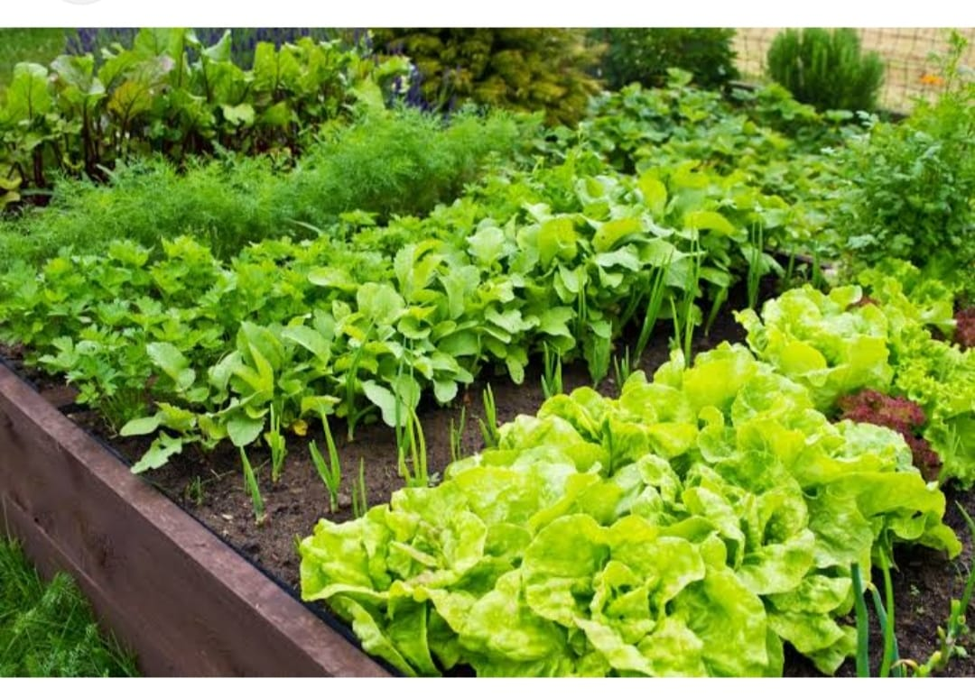
3. Implementation of land reforms:-
For improving the production, land reforms are the first and predominant point. Machines,tractors, and implements do land reforms. These machine have the qualities that make rugged farming areas smooth to work on the field efficiently. Working on the field is easy, that means an improvement in productivity is easy. Land reforms are the best method to increase production.
4. Interplant:-
Interplantion is a practice in which different crops are growing together at the same time. It is the best way to maximize the productivity of your growing space. Some crops are the best together, some not.

Slide 7
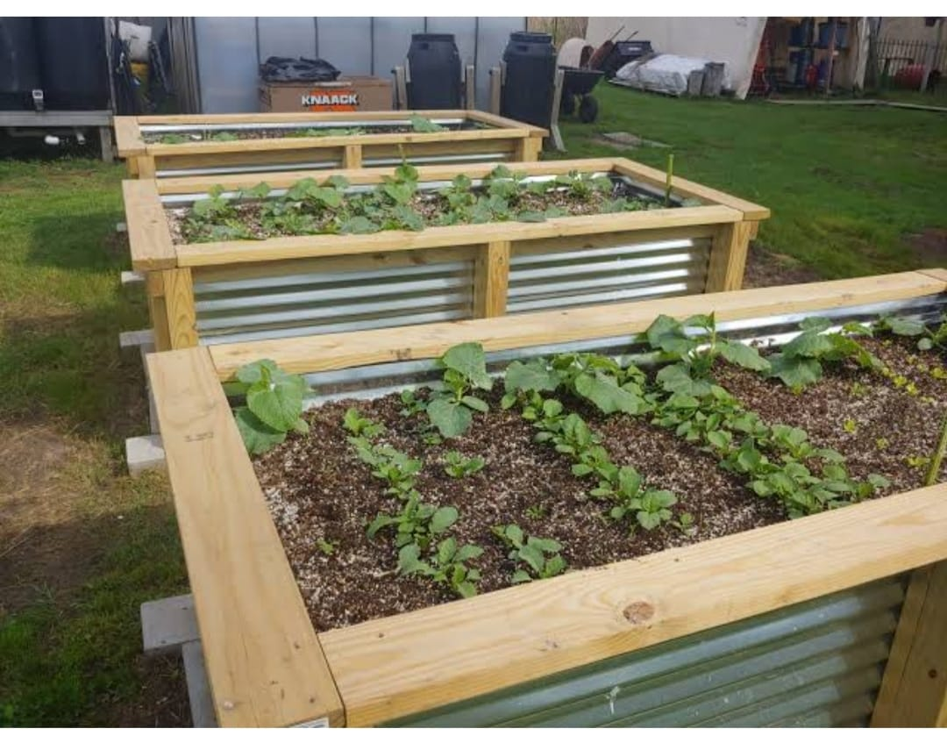
5. Plant many crops:-
The next method of improving productivity is to plant many crops.
6. Plant more densely :-
It is the simplest way to improve the productivity of farms, in this plant crops close together. Many farmers keep their vegetables excessively away, which leads to the abandonment of large areas growing well.
7. Raised beds:-
Traditional farming system place crops in separate rows by tractor paths, with permanent beds planting multiple rows of crops within beds of the same width. It creates dense plantations, fewer pathways, and more active growing areas. Raised beds are symbolic of improving the productivity of crops.

Slide 8
8. Smart water management:-
Water is an essential need for planting crops, and by the management of water, we can enhance the production. Water management is the best way to improve production. Using the sprinkle irrigation system, we can increase the output by up to 50%. But the manufacturing canals, tube wells get a better irrigation system for the safety of crops.
9. Use nitrogen:-
Nitrogen is a necessary element for better plant growth, and without nitrogen, most of the crops would not exist. Annually, plus 100 million tonnes of nitrogen are applied to crops in the forms of fertilizer to help them grow stronger and better. The use of nitrogen can enhance the production of up to 22%.

Slide 9
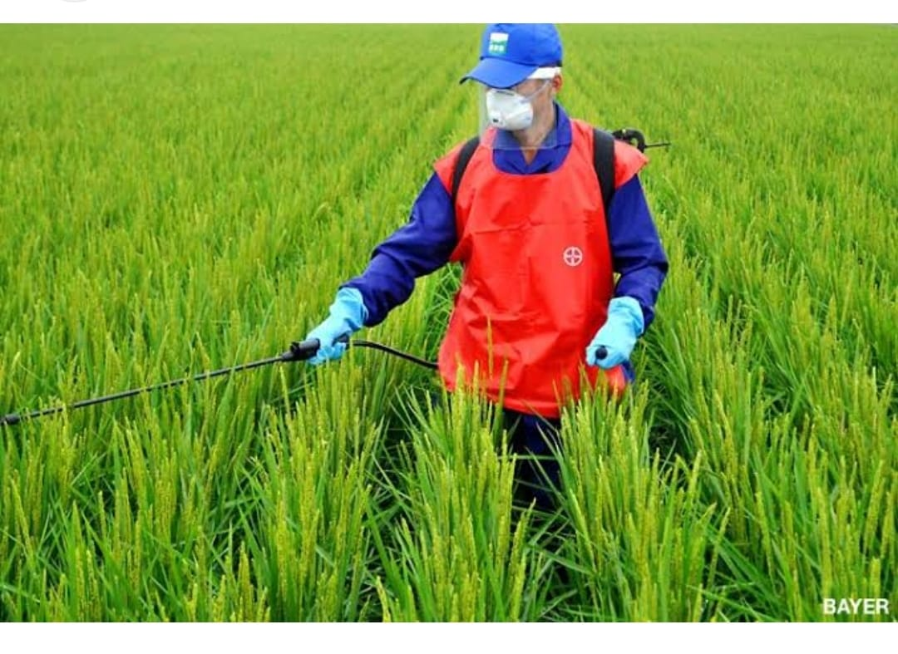
10. Improve seeds:-
Seed play an essential role in the farms, and improved seeds are the best to enhance farm productivity. Improved seeds are suitable for increasing production.
11. Plant protection:-
According to farming scientists, about 5% of crops destroyed by insects, pests, and diseases. Most of the farmers are oblivious of the use of medicine and insecticides develped in recent years. Improving the production of the crops, yields must use these medicines. To be aware, the farmers about these government should take steps or employ their technical staff in spraying pesticides and insecticides.

Slide 10
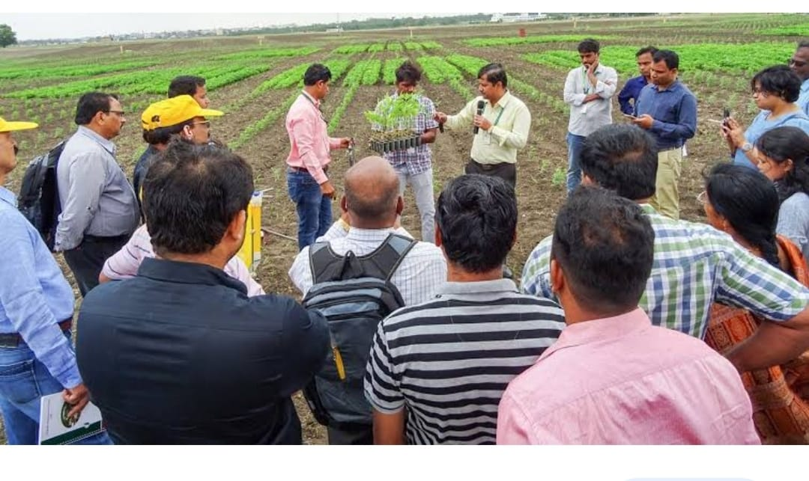
12. Farmers Education:-
Farmers have to be educated to utilize their resources in an optimum manner. Eduaction of an integrated and efficient management of land and water resources is neded to avoid the problem of land degradation. Education supplements better skilled management for raising the level of productivity. Better agriculture research for soil testing and conservation is needed. Suitable agro-climate regional planning is also required to increase the agriculture productivity in India.
13. Improving the Returns to Farmers:-
For this,both price measures and non- price measures have to be implemented. Raising minimum support prices for the crops, giving necessary subsidies for agriculture inputs, provindin crop insurance facility, reducing the population pressure on land by increasing non-farm economic activities and introducing managerial concepts in agriculture definitely help to increase agriculture productivity.

Slide 11
THANK YOU...

